Slide 1
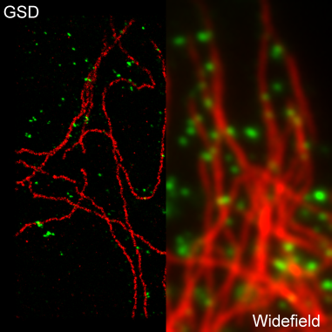
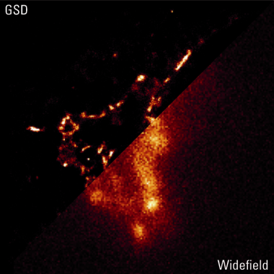
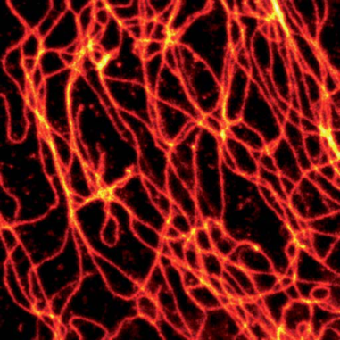
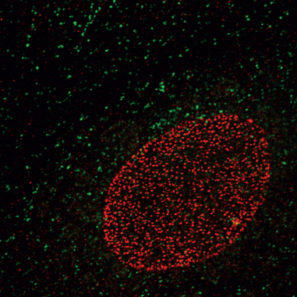
Technology Seminar
1. Super-resolution Imaging by Ground State Depletion (GSD)
Speaker: Dr Christian May
Product Manager, Wide-Field Technologies, Leica Microsystems Ltd
2. Stimulated Emission Depletion (STED)
Speaker: Dr Jochen Sieber
Product Manager Super-resolution Technologies, Leica Microsystems Ltd
10 January 2012
4:30p.m. – 6:00p.m.
Anatomy Seminar Room, L1-19, 1/F, Laboratory Block, 21 Sassoon Road, Faculty of Medicine Building, The University of Hong Kong.
Co-organized by:
Faculty Core Facility - The University of Hong Kong
Leica Microsystems Ltd
All are Welcome!
Ptk2-cells. NPC-staining:
anti-NUP153/Alexa Fluor® 532
Microtubule-staining:
anti--tubulin/Alexa Fluor® 647
Courtesy: Wernher Fouquet, Leica Microsystems
In collaboration with Anna Szymborska and Jan Ellenberg, EMBL, Heidelberg, Germany.
Analysis of the spatial distribution of
Syntaxin by STED within the basal plasma membrane of PC12 cells. STED microscopy allowed the investigation of cluster density
and the determination of average
Cluster sizes of 50 – 60 nm.
[Science, Sieber JJ., 2007]

